Slide 1
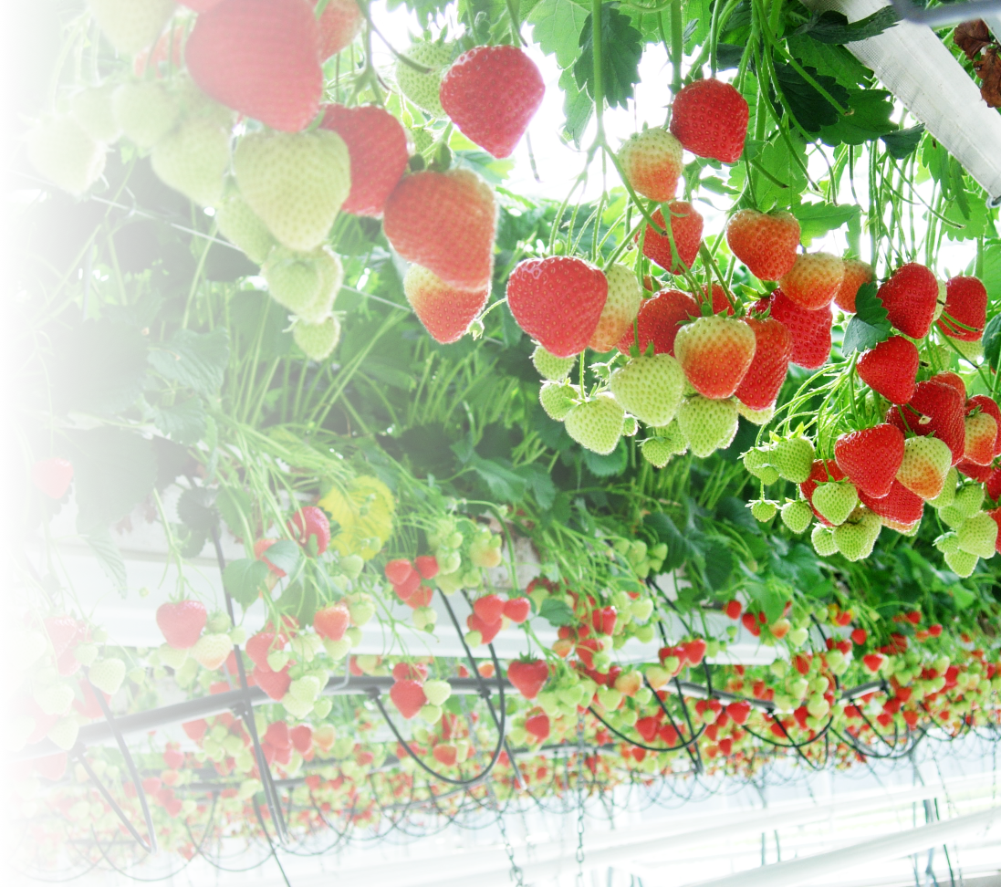
Horti-BlueC
Direct reuse of spent coir growing medium in tabletop strawberry production
Xiangming Xu
NIAB EMR, UK

Slide 2
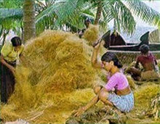
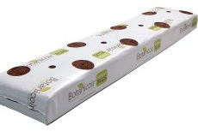
Background
Coconut coir, a by-product of coconut production, is the main strawberry growing medium in the UK.
It is a more sustainable option than peat-based media
It is usually used only for one growing season and occasionally for two seasons
Spent coir is not re-used primarily because of the perceived yield decline associated with spent coir

Slide 3
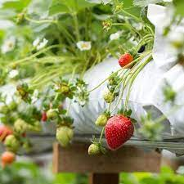
Aims
Determine strawberry fruit yield and quality in used and fresh coir.
Determine if biochar amendment of used coir affects fruit yield and quality.

Slide 4
Experimental approaches
Biochar
 |  | Oak |  |  |  | Mixed wood |  |  |  | Unamended
Coir age |  | 0 | 1 | 2 | 3 | 0 | 1 | 2 | 3 | 0 | 1 | 2 | 3
Year | 2018 | x | x |  |  | x | x |  |  | x | x
 | 2019 | x | x | x |  | x | x | x |  | x | x | x
 | 2020 | x | x | x | x | x | x | x | x | x | x | x | x
Biochar was added once at the beginning:
Fresh or one-season-old coir in 2018
Only fresh coir in 2019 and 2020
Coir bags from 2018 reused in 2019, and those from 2019 reused in 2020

Slide 5
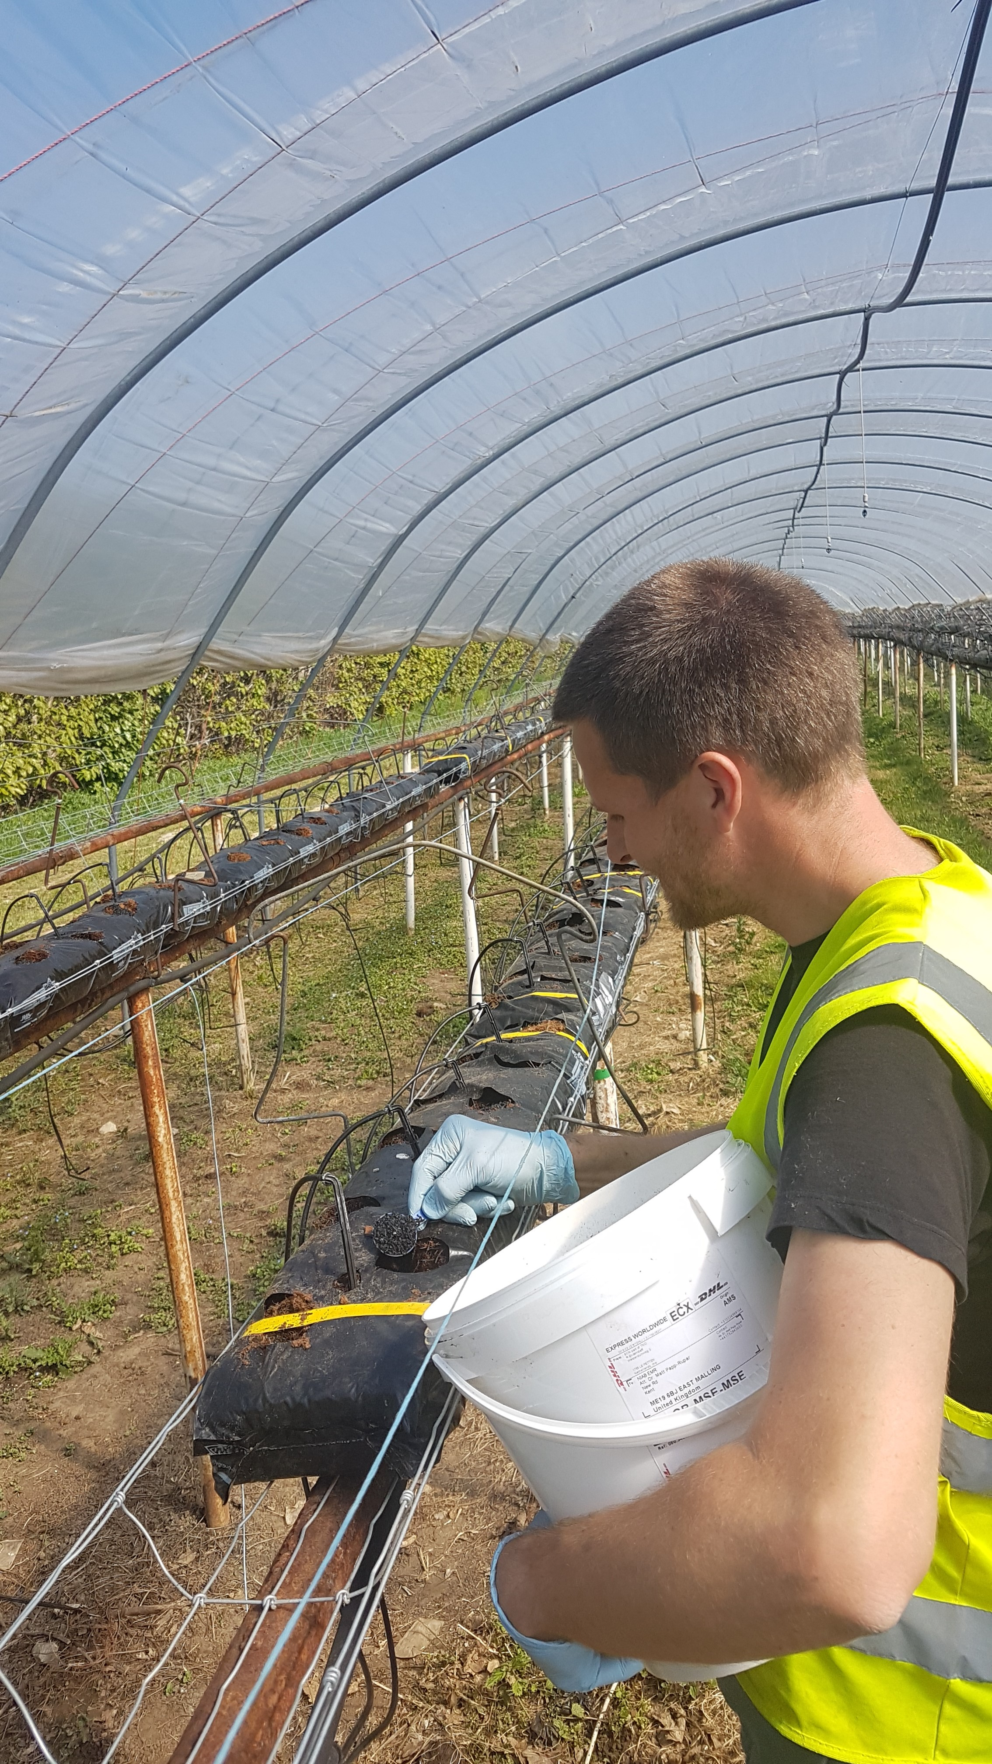
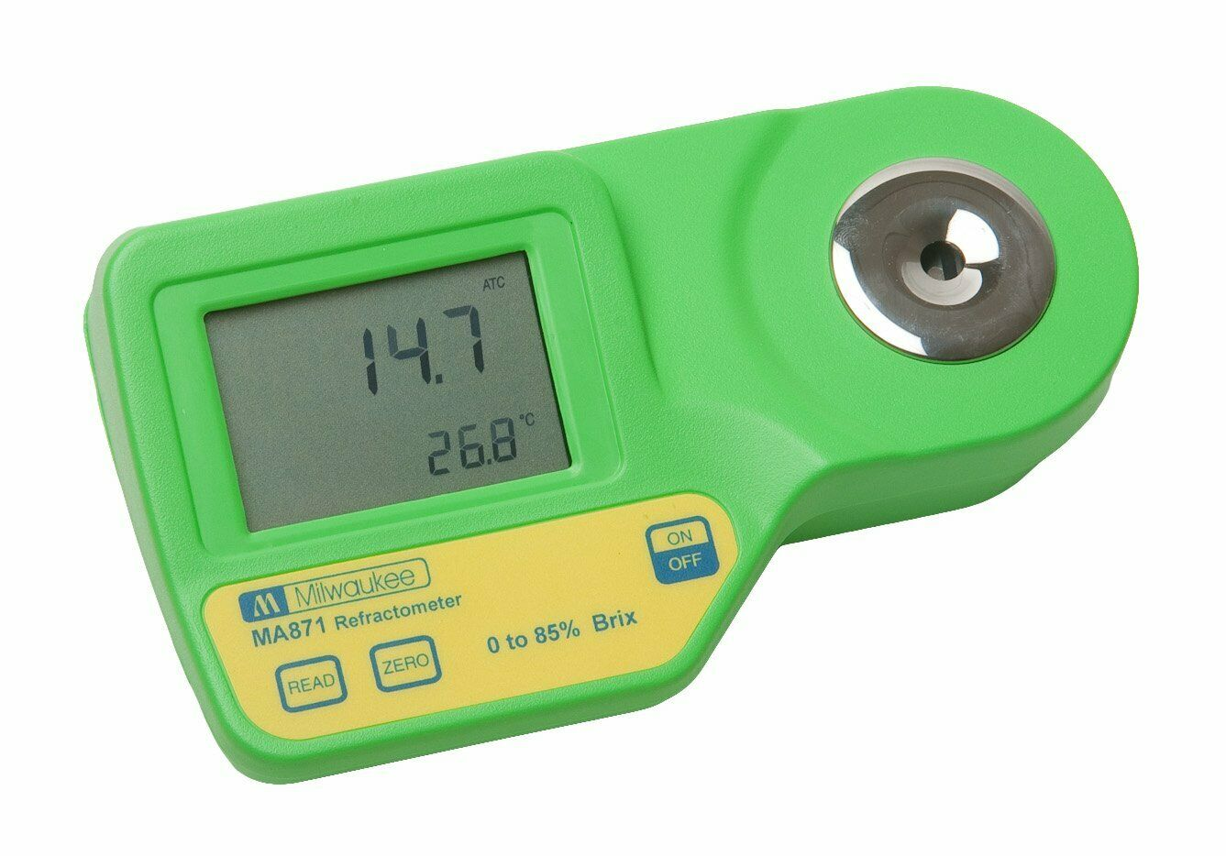
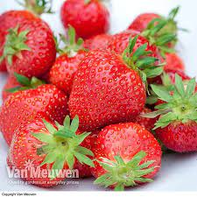
Experimental design
Random block design with four blocks
Each plot has four coir bags assigned to one treatment (8-10 plants each bag)
A June-bearer cultivar used in 2018 and 2019, an ever-bearer cultivar used in 2020
Planted late in 2020 due to covid
Yield, brix and plant mortality were assessed

Slide 6
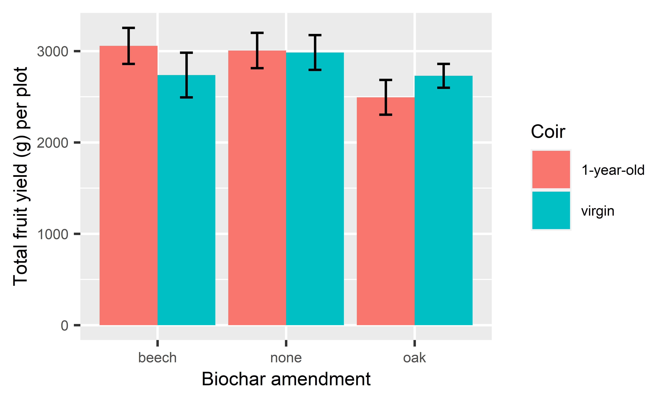
Results - 2018
Yield did not differ between coir ages and between biochar treatments

Slide 7
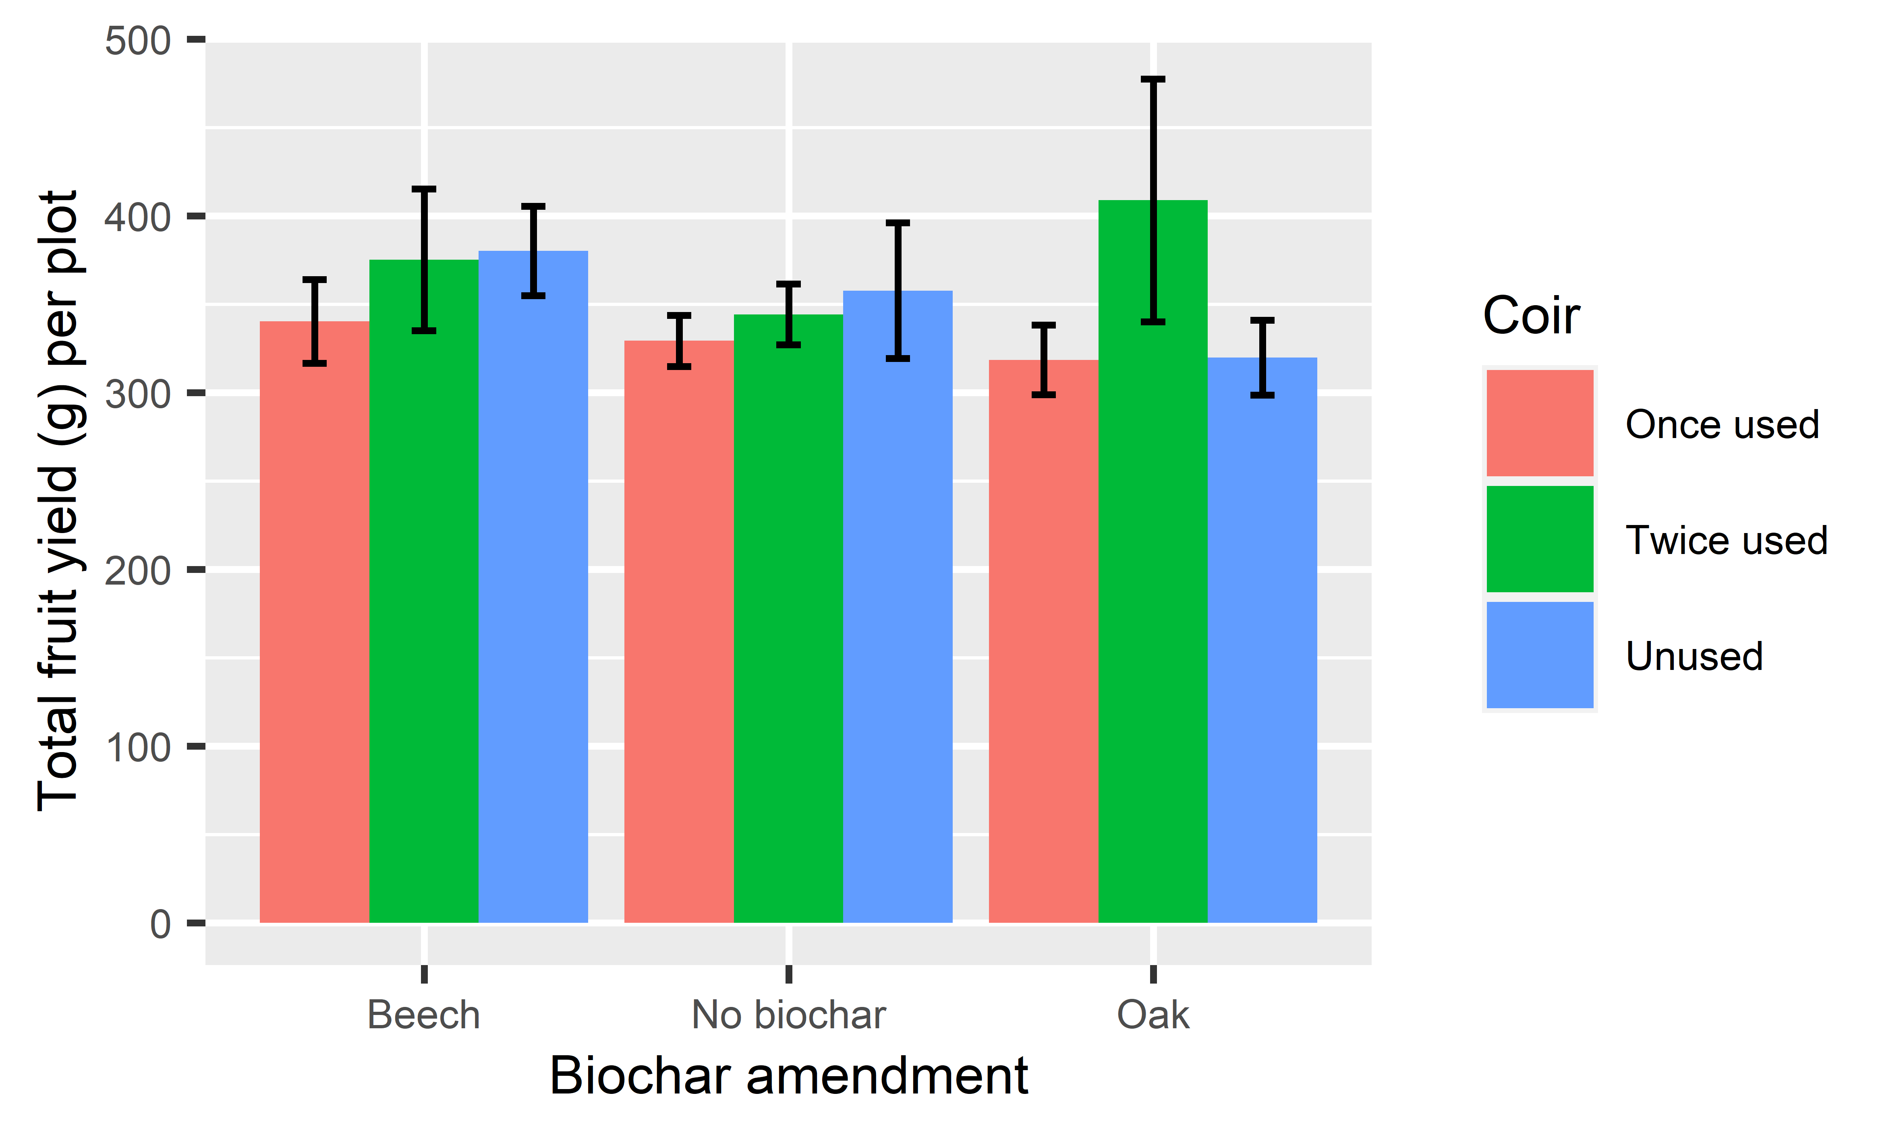
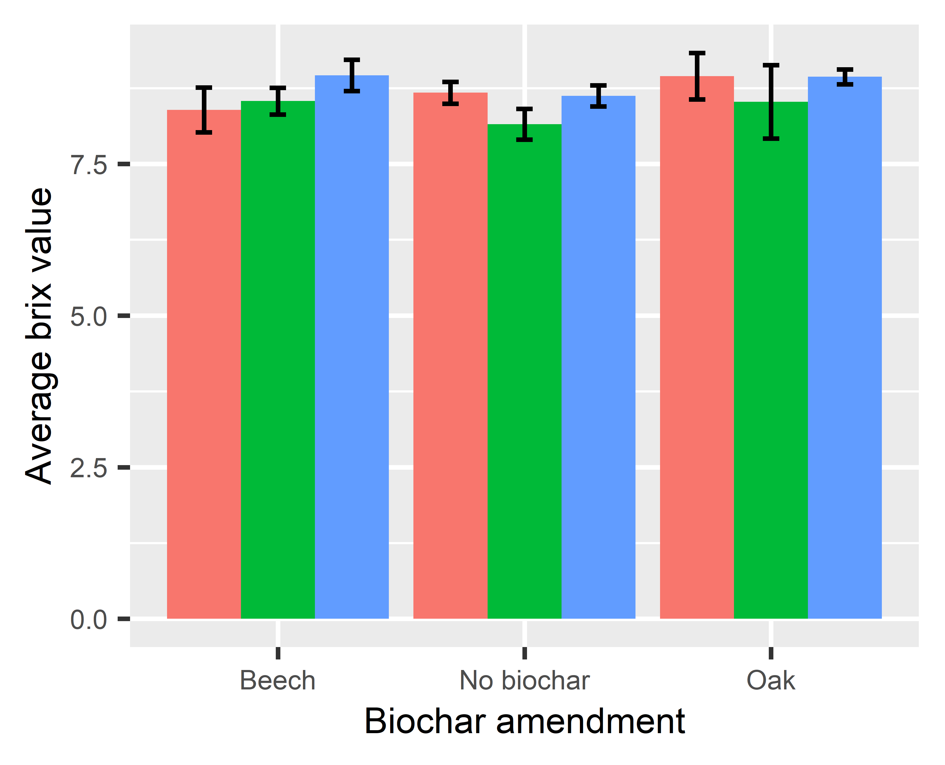
Results - 2019

Slide 8
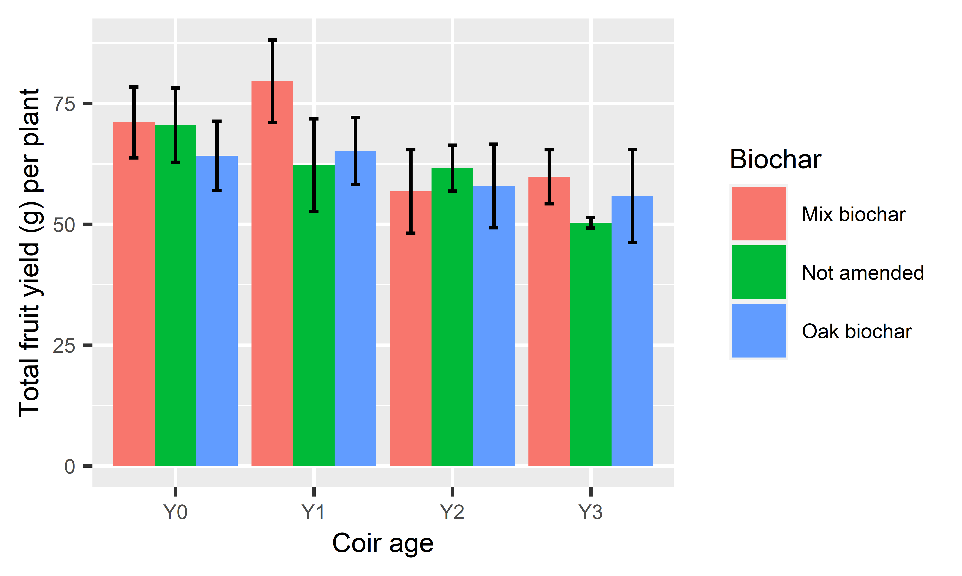
Results - 2020
Yield differed between coir ages but not between biochar treatments

Slide 9
Results - 2020
Yield reduction at an annual rate of 6.7%, irrespective of biochar amendment

Slide 10
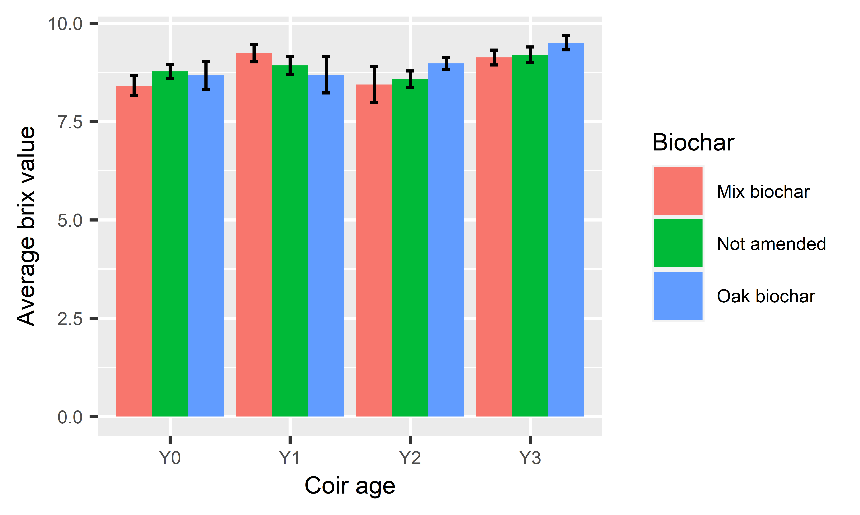
Results - 2020
Brix levels did not differ between all treatments

Slide 11
Conclusions
There was a small but significant yield decline associated with used coir
Such a decline does not offset the cost associated with buying/managing fresh coir
In the near future, we are going to investigate whether using beneficial microbes might improve productivity in spent coir

Slide 12
Acknowledgements
Interreg 2 Seas programme 2014-2020 co-funded by the European Regional Development Fund under subsidy contract No 2S03-046, and Berry Gardens Ltd, UK.
ILVO and TNO supplied biochar
The NIAB EMR pathology team

