Slide 1
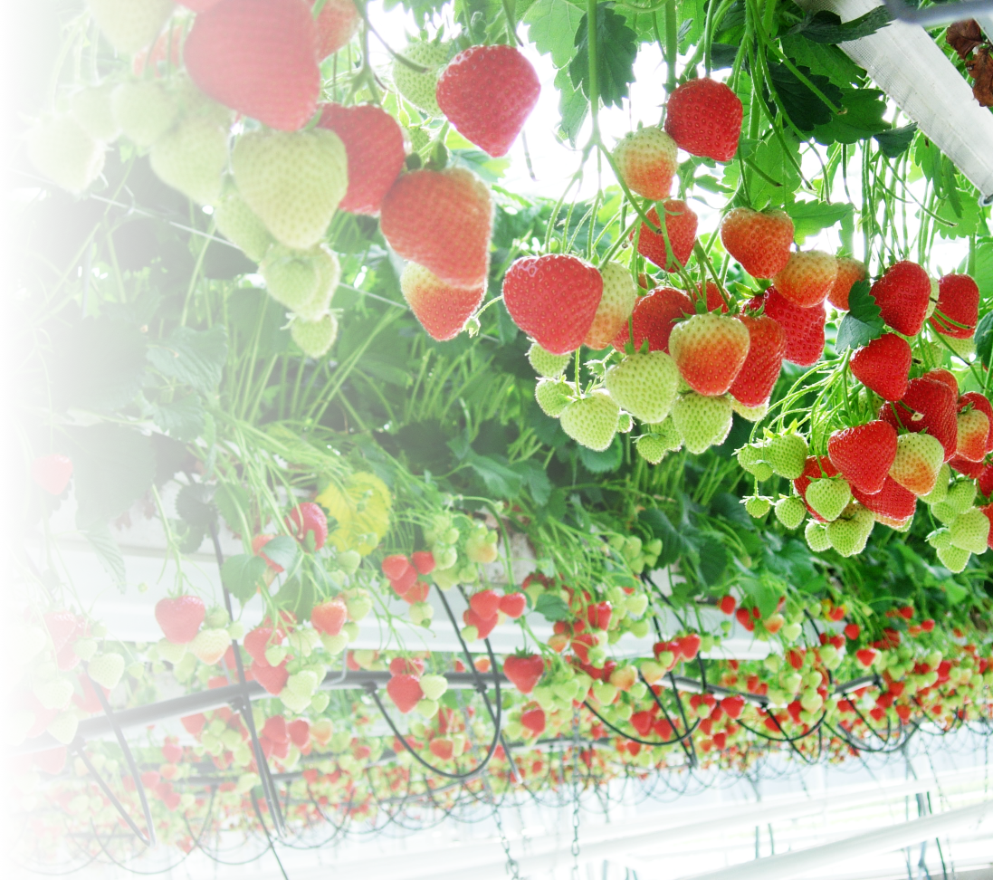
Amending Butterhead Lettuce and Brioso Tomato with Recycled
Shellfish Food Waste to Improve Yield and Antioxidant Activity
Edward Collins
2nd ISHS International Symposium on Growing Media
Notes:
Title Slide:
Hi everyone, today I am going to tell you all a bit about the crop trials I carried out for Horti-BlueC

Slide 2
Lettuce Study
Growing media of butterhead lettuces (Lactuca sativa) supplemented with chitin (1, 2, 3% w/w)
Chitin derived from shrimp and crab shells
Plant growth rate, yield, and leaf antioxidant activity were all measured
Notes:
Lettuce Study:
The growing media of butterhead lettuce (Lactuca sativa) was supplemented with chitin derived from crab and shrimp shells from fishery waste streams in dry weight percentages 1, 2, 3% (w/w).
The crab chitin tested was a commercially available chitin from Biolog Heppe, which we were comparing to a shrimp chitin prepared by ILVO for Horti-BlueC.
For each type of chitin there was 4 replicates per chitin percentage treatment. Measurements taken included leaf production rate, fresh mass yield, and antioxidant activity.
Other measurements made during the course of this trial include leaf expansion rate, leaf chlorophyll fluorescence and chlorophyll content, using standard technique. Also, moisture content, electrical conductivity, and temperature of the growing media were monitored throughout the trial. Finally leaf mass area and specific leaf area were measured with the fresh and dry mass yield of the lettuces. Using this, the water content of the crop at harvest was calculated.

Slide 3
Lettuce Fresh Mass Yield
Shrimp Chitin
Crab Chitin
Figure 1. Average fresh mass yield. Error bars represent the standard error (n = 4). ANOVA analysis showed no significant differences.
Notes:
Lettuce Fresh Mass Yield:
As can be seen from figure 1, 2% chitin treatments for both types of chitins, had the highest average fresh mass at harvest of the whole plant. In both chitin treatments, the 1% chitin treatment obtained the second highest average fresh mass, followed by the 3% chitin treatment. In both studies, the control had the lowest average fresh mass yield.
The differences seen in overall mass is due to the studies happening at different times of year, the shrimp chitin study happened in the heat of summer and so resulted in larger lettuces, however the trend seen in both is the same.
The 2% and 3% shrimp chitin treatments can be seen to have a leaf number lower than that of the control, but a higher fresh mass at harvest – this was explained by measuring the fresh to dry mass ratio in harvested leaves which showed that 2% and 3% shrimp chitin treatment leaves had a higher water content.

Slide 4
Lettuce Leaf Production
1% 2% 3% 1% 2% 3%
Shrimp Chitin
Crab Chitin
Figure 2. Leaf production represented as percentage change compared to the control. Measurements were taken 35 days after seed germination. Error bars represent the standard error of each average (n = 4).
Notes:
Lettuce Leaf Production:
The graph shown here (figure 2) represents the average percentage change in leaf number compared to the control, for both shrimp and crab chitin treatments.
As can be seen in figure 1, the 1% shrimp chitin treatment had the highest average change in leaf number compared to the control – this was consistent over the course of the trial.
2% shrimp chitin treatment lettuces consistently had a lower leaf number than the control throughout the trial and 3% shrimp consistently had the lowest average number of leaves compared to the control throughout the trial.
This was an early indication to us that there might be an upper limit to how much chitin could be added to lettuces.
Figure 2 also shows that the trend is slightly different in crab chitin: 1% crab chitin treatment again had the highest average number of leaves compared to the control over the course of the trial, 2% and 3% crab chitin treatments showed an overall percentage increase compared to the control.
The 2% and 3% shrimp chitin treatments can be seen to have a leaf number lower than that of the control, but a higher fresh mass at harvest – this was explained by measuring the fresh to dry mass ratio in harvested leaves which showed that 2% and 3% shrimp chitin treatment leaves had a higher water content.

Slide 5
Lettuce Leaf Antioxidant Activity (FRAP Assay)
*
*
Figure 3. Average concentration of reducing antioxidants. Error bars represent standard error (n = 4). * Represents a significant difference found in a one-way ANOVA test (P<0.05).
Notes:
Lettuce Leaf Frap Assay:
As well as how the chitin amendments impacted yield we also wanted to measure how it impact the nutrients obtained by the crop. One of the ways this is done is by measuring the antioxidants found in a sample.
Antioxidants, present in plant cells, protect against high levels of free radicals produced in response to stressors, radiation, and redox reactions. Naturally occurring antioxidants, found in all plant tissues, include vitamins, terpenoids such as carotenoids, and phenolic constitutes such as flavonoids and phenolic acids.
As mammals we can only produce a few antioxidants to protect ourselves, and rely on antioxidants being introduced to our bodies as part of our diet.
To determine antioxidant content and activity from a plant sample, antioxidant assays are carried out. The FRAP assay is one of the most widely used antioxidant assays in research measuring the reducing ability of a sample.
The reducing ability of the L. sativa leaf samples grown in media containing different percentages of crab chitin showed a significant increase in the antioxidant activity of leaves grown with 2% and 3% chitin, compared with 0% and 1% (figure 3). This suggests that samples grown with a higher concentration of chitin in growing media can result in leaves with a higher antioxidant activity.

Slide 6
Lettuce Leaf Phenolic Content (Folin’s Assay)
*
*
*
Figure 4. Average concentration of total polyphenols. Error bars represent standard error (n = 4). * Represents a significant difference found in a one-way ANOVA test (P<0.05).
Notes:
Lettuce Leaf Folin’s Assay:
This trend was also seen in the Folin’s assay (figure 4), an assay which measures the total polyphenol content of a sample. There is a proportional relationship between the percentage of chitin and the amount of phenolics in the sample.
The data indicates that the chitin treatment increases the antioxidant content and activity of the L. sativa leaves. All chitin treatments were seen to have a significantly increased phenolic content compared to the control.
Leaf material from both trials was frozen at -80oC for further testing in these assays and in two other antioxidant assays optimised for L. sativa leaf sample.

Slide 7
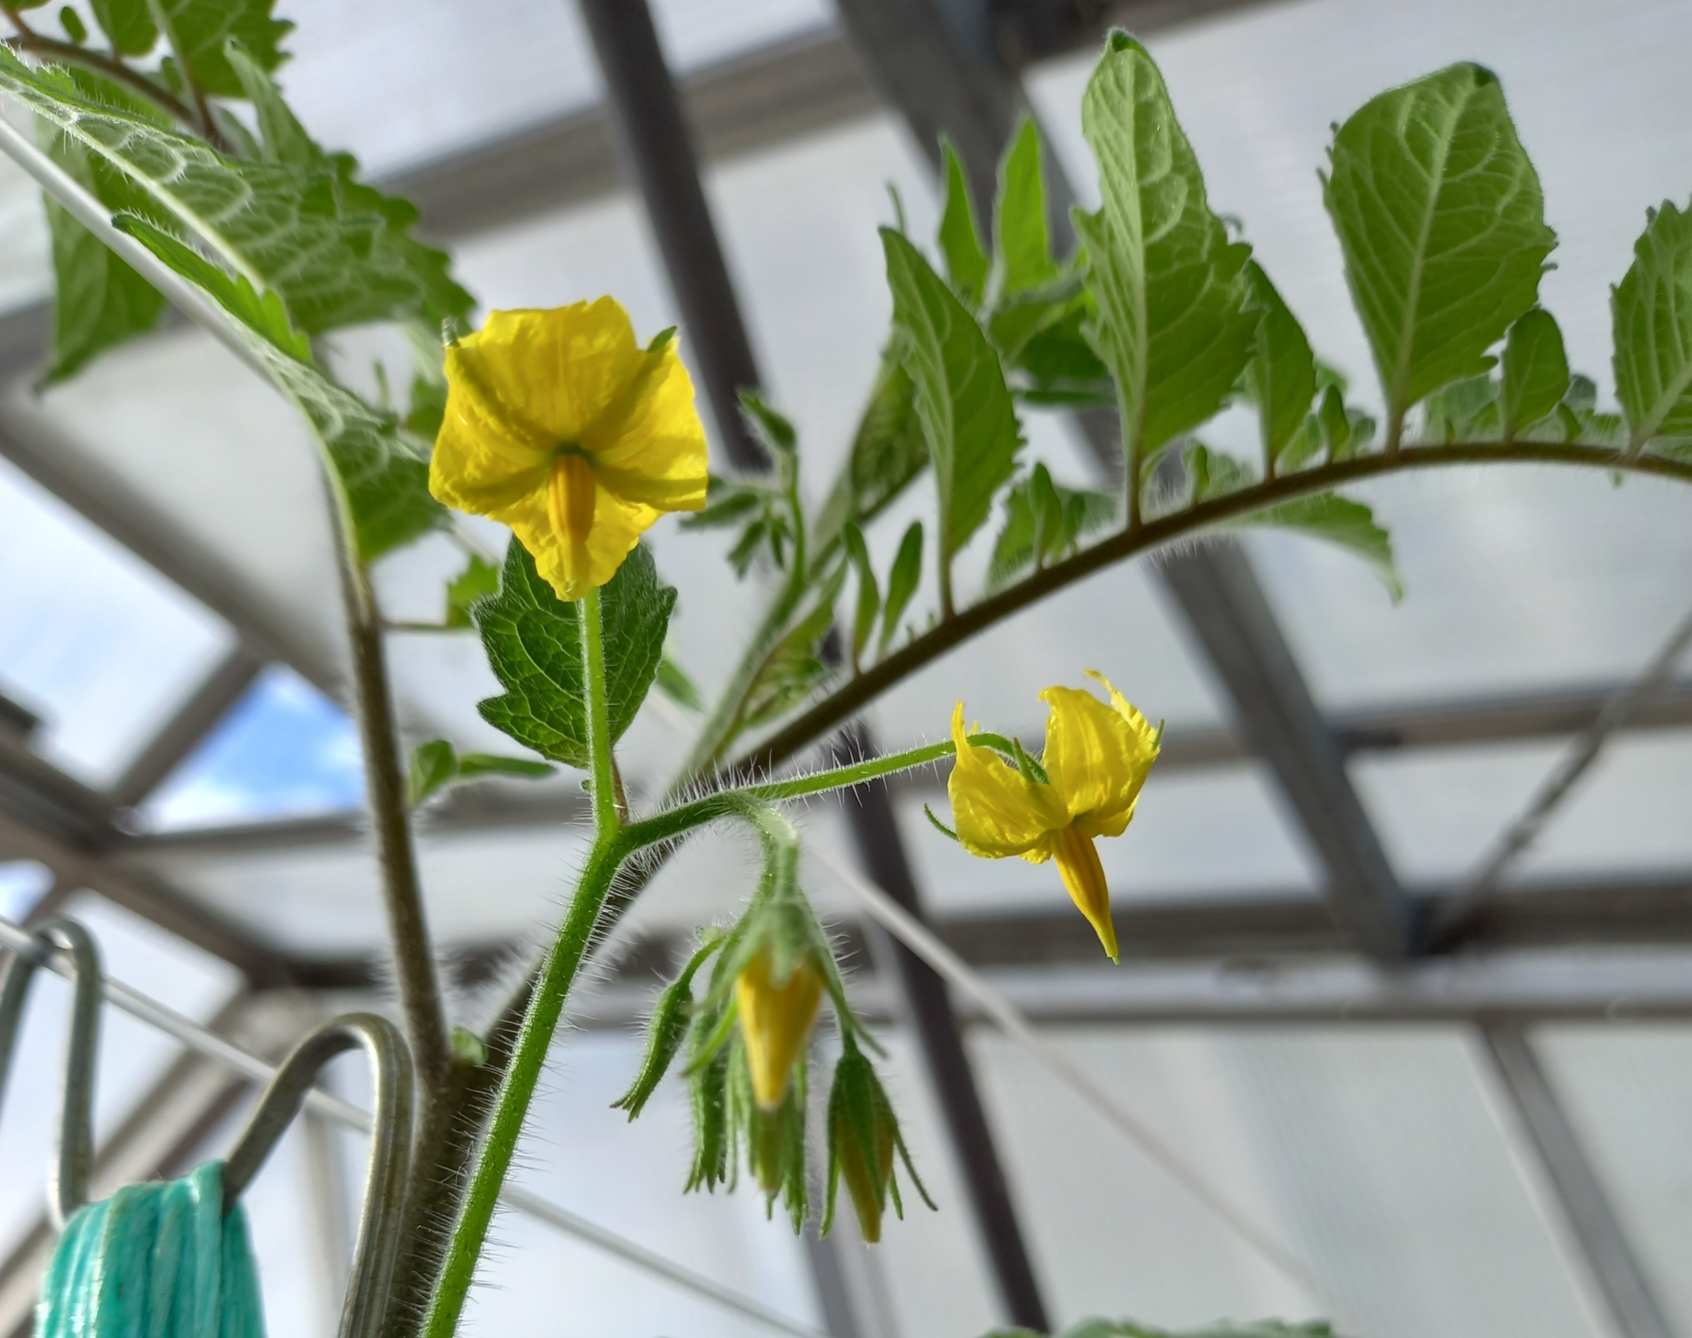
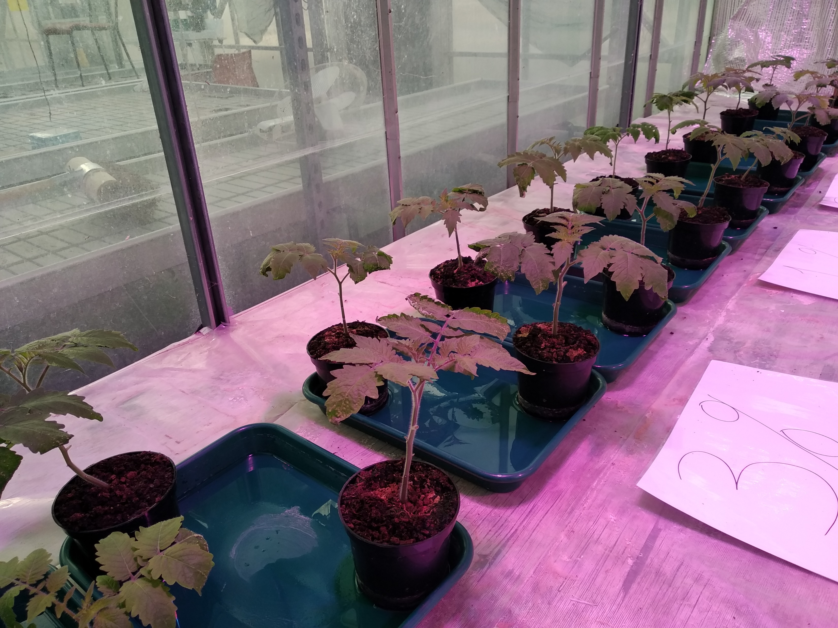
Tomato Study
Growing media of Brioso tomato plants (Solanum lycopersicum) supplemented with chitin (0.2%, 1, 2, 3% w/w)
Chitin derived from shrimp shells sourced from fishery waste streams was selected to test for tomatoes
Plant growth rate, fruit yield and antioxidant activity are all
being measured
Notes:
Tomato Study:
After we tested butterhead lettuces we also tested Brioso tomato plants (Solanum lycopersicum) with chitin amended growing media in the dry weight percentages 0.2%, 1%, 2%, and 3%
We only had the resources to test one type of chitin and so we decided to just focus on testing the shrimp-derived chitin from Horti-BlueC
This trial is still being carried out now and we have 4 replicates per chitin percentage treatment and we are measuring plant growth rate, using the measuring techniques as used in the lettuce trial
Fruit yield and antioxidant activity of the fruit will also be measured in this trial

Slide 8
Tomato Preliminary Results: Leaf Area Increase
Crab Chitin Percentage
Figure 5. Average leaf area increase for tomatoes grown with increasing percentages of shrimp chitin. Error bars represent standard error (n = 4).
Notes:
Tomato Preliminary Results: Leaf Area Increase
This study is still ongoing and so I have not collected any fruit data yet. However, here are my preliminary results from measuring the tomato leaf growth rates.
Figure 5 represents the daily change in leaf area of one leaf per tomato plant over 14 days starting 40 days after germination.
The controls increase gradually at around 250-500 mm2 a day until day 54, however, the leaves of chitin-treated plants show a greater rate of expansion at around 500-1000 mm2 a day for the first 7 days and then this expansion becomes negative as the leaves begin to shrink. This could imply that chitin is increasing the development of leaves as they grow to maturity sooner and senesce.
The highest rate of leaf expansion was seen in tomato plants grown with 3% chitin, followed by 1% chitin and 2% chitin treated tomatoes.

Slide 9
Tomato Preliminary Results: Leaf Chlorophyll
Figures 6 & 7. Average activity of PSII (left) and content (right) for tomatoes grown with increasing percentages of shrimp chitin. Error bars represent standard error (n = 4).
Notes:
Tomato Preliminary Results: Leaf Chlorophyll
The chlorophyll fluorescence and content were measured for the leaves of all tomato plants.
Chlorophyll fluorescence, shown in figure 6 on the left, measures the quantum efficiency of photosystem 2 and can be used as an indicator of plant stress, in which the higher the measurement, the lower the stress. No significant differences were found in these measurements, indicating that the chitin amendments were not causing any stress to the plants.
Figure 7, on the right, shows the chlorophyll content of the leaves of all tomato plants which can also be used to test the stress conditions of a plant. Again, no significant differences were found, suggesting the chitin does not stress the tomato plants in their growth.

Slide 10
Tomato Study: Further Measurements
Further plant growth rate measurement
Fruit yield measurement and comparison
Fruit antioxidant activities to be compared
X-ray imaging for comparison of root structures
Mineral analysis of growing media to compare nutrient levels
Notes:
Tomato Study: Further Measurements
By the end of our tomato trial we will have many more results to compare between the chitin treatments.
The most important of these are the fruit yield measurements, telling us if the concentration of chitin affects that in any way. And also, the fruit antioxidant data, which will tell us if the chitin percentage can alter how healthy these tomatoes are to eat.
We will also measure root size and structure using x-ray imaging to see if the concentration of chitin in the growing media has, in any way, impacted the growth of the roots.
Finally, the mineral composition of the chitin-amended growing media will be tested to see the difference in nutrients between the different percentages of chitin.

Slide 11
Summary
Chitin
1% and 2% chitin resulted in largest yield for lettuce
Chitin-amended growing media appears to increase lettuce antioxidant activity
Chitin-amended growing media has increased the leaf expansion of tomato plants and impacted the efficiency of chlorophyll in leaves
Notes:
Summary:
To sum up - we saw in our lettuce trial that chitin percentages 1% and 2% resulted in the largest fresh mass yield, and that 3% chitin led to a slight decrease in yield, in comparison. This suggested to us that an ‘optimum range’ of chitin should be used as a growing media amendment. We are excited to see how this impacts the fruits from the tomato trial.
We saw that the percentage of chitin in growing media increased the antioxidant activity of lettuce leaves, but this should be taken with the effects on leaf yield. 1% or 2% chitin would result in the largest leaves with the most antioxidants.
The chitin-amended growing media has resulted in an increased leaf expansion rate and we will see how this affects fruit yield and antioxidant activity later in our trial.

Slide 12
Work with ADAS: Antioxidant Activity (FRAP Assay)
*
Figure 8. Average reducing ability for tomatoes grown with increasing percentages of shrimp chitin. Error bars represent standard error (n = 3). * Represents a significant difference found in a one-way ANOVA test (P<0.05).
Notes:
Work with ADAS: Antioxidant Assays (FRAP)
Finally, I just wanted to go over some results we obtained testing samples sent to us by ADAS.
We received tomato samples from ADAS grown on Horti-BlueC novel media blends consisting of peat free coconut coir, bark, and woody fibres. In addition to this control blend, two others were tested amended with either 2 kg/m 3 chitin or 2 kg/m 3 biochar. A Millenium Ultima coir slab and a rockwool slab were also utilised as other controls in this trial.
Tomatoes grown on these growing media blends were tested in the same antioxidant assays used for our own studies.
For the FRAP assay, the Millenium Ultima coir slab tomato samples were shown to have a significantly different reducing ability compared to the growing media blends. Tomato samples grown on rockwool slabs showed a consistently lower reducing ability compared to the Horti-BlueC novel media blends.
These results indicate that tomatoes grown on Horti-BlueC novel media blends have a higher antioxidant activity compared to those grown on just rockwool or Millenium Ultima coir slabs

Slide 13
Work with ADAS: Phenolic Content (Folin’s Assay)
Figure 9. Total polyphenol content for tomatoes grown with increasing percentages of shrimp chitin. Error bars represent standard error (n = 3).
Notes:
Work with ADAS: Antioxidant Assays (Phenolics)
The results of the Folin’s assays, measuring the total polyphenol content of the fruit, shown here, mirrored those of the FRAP assays. The Millenium Ultima coir slab tomatoes showed the lowest total polyphenol content compared to the other samples tested. The rockwool samples were also seen to have the second lowest total polyphenol content of all samples.
This suggested that the Horti-BlueC novel media blends resulted in fruit with a higher average total polyphenol content. However, no significant differences were found with this assay.

Slide 14
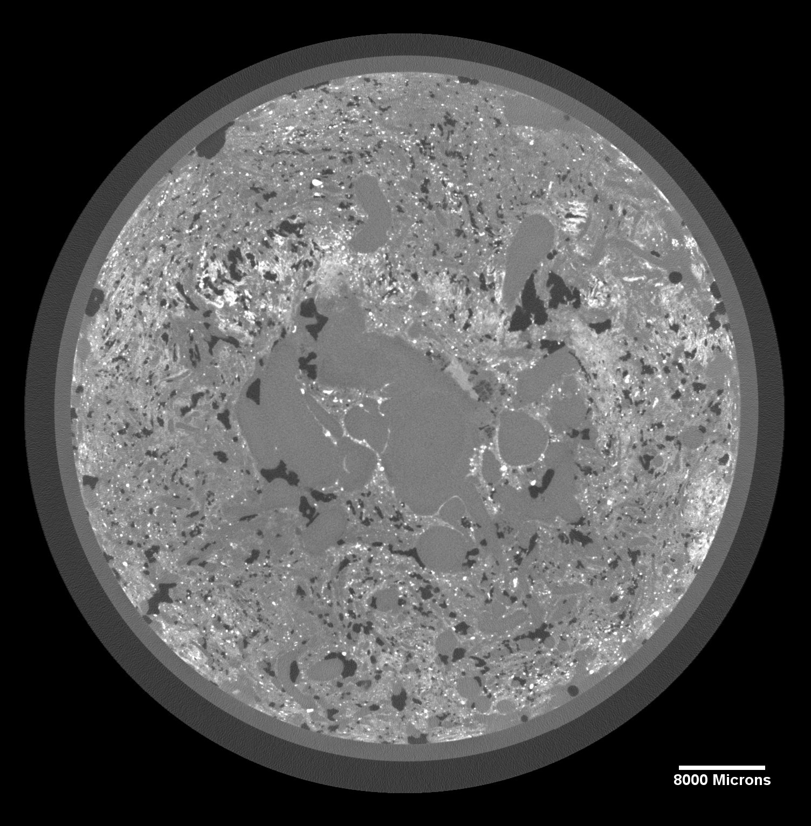
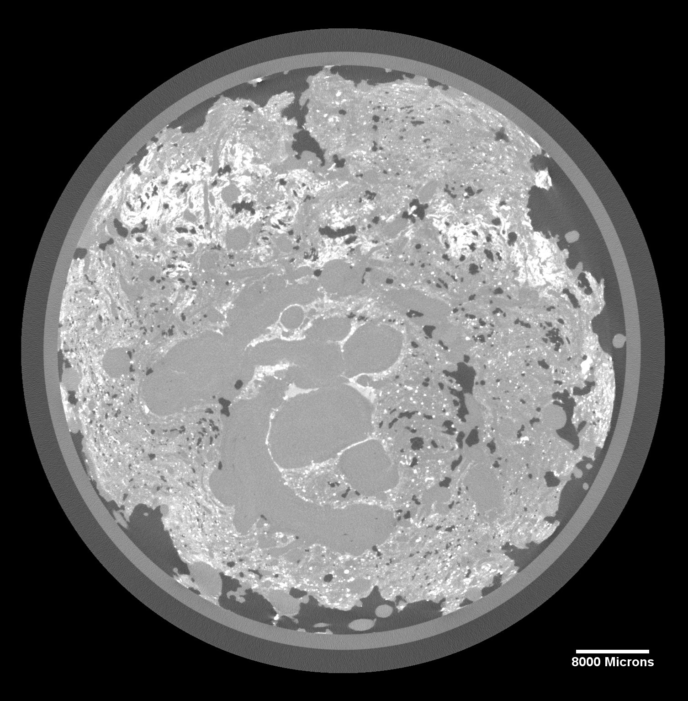
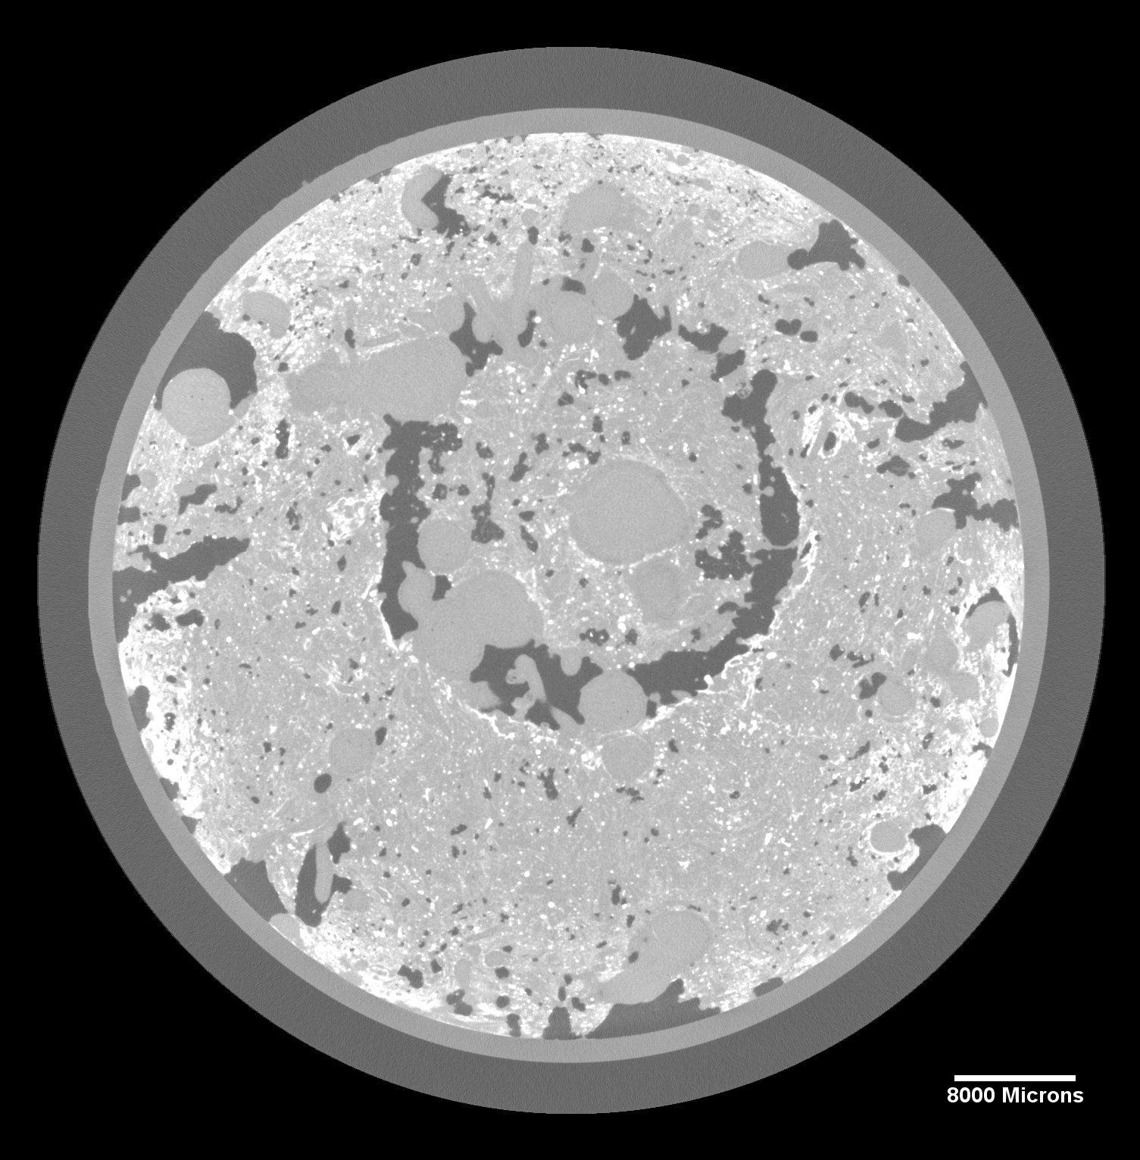
Work with ADAS: X-ray Imaging
HBC-W2-BL-01_T HBC-W2-BL-02_T HBC-W2-BL-03_T
Figure 10. X-ray imaging scans of tomato root structures in Horti-BlueC novel media blends.
Notes:
Work with ADAS: X-ray Imaging
We also received Horti-BlueC novel media blends containing tomato root structures for us to analyse in x-ray imaging. We use this as a way of comparing root size and structure without causing any damage to the roots.
A core drill was used to cut out a cylinder of media at the base of the stem approximately 10 cm in diameter and 20 cm in height, as shown in the above picture. This cylinder was then transferred to a clear plastic tube and sealed shut.
Imaging of roots was carried out at 50 microns in order to obtain a good resolution of the root images. These images were stitched together into a video travelling vertically through the root sample in order to note any differences between roots grown in the three media.
When the diameter of the root structures imaged was measured, no significant differences were observed. A scale bar can be seen in all images comparing the size of root structure in the chosen photo of the sample.
Images were taken throughout the sample as vertical cross sections and were put together as a video. The photos shown in here are of corresponding vertical positions in each sample so that a comparison of root structure could be made. Any area in the images which appear lighter are denser, compared with darker colours which are less dense. Root structures are visible as circular shapes towards the centres of the image.

Slide 15
References
Yan, N. and Chen, X. (2015) ‘Sustainability: Don’t waste seafood waste’, Nature. Nature Publishing Group, pp. 155–157. doi: 10.1038/524155a.
OF THE EUROPEAN PARLIAMENT AND OF THE COUNCIL laying down health rules as regards animal by-products and derived products not intended for human consumption and repealing Regulation (EC) No 1774/2002 (Animal by-products Regulation) (2009).
Chibu, H. (2000) ‘Effects of chitosan applications on the growth of several crops’, Korean Journal of Chitin Chitosan, 5(3), p. 182.
Wanichpongpan, P., Suriyachan, K. and Chandrkrachang, S. (2001) ‘Effect of chitosan on the growth of Gerbera flower plant (Gerbera jamesonii)’, Chitin and chitosan: chitin and chitosan in life science, Yamaguchi, Japan, pp. 198–201.

Slide 16
Thank you for listening
Any questions or feedback?
This project has received funding from the Interreg 2 Seas Programme 2014-2020 co-funded by the European Regional Development fund under subsidy contract No 2S03-046 Horti-BlueC

Slide 17
Work with ADAS: Antioxidant Assays (DPPH)
Figure 10. Average free radical scavenging activity for tomatoes grown with increasing percentages of shrimp chitin. Error bars represent standard error (n = 3).
Notes:
Work with ADAS: Antioxidant Assays (DPPH)
The DPPH assay showed that Millenium Ultima coir slab tomato samples also had the lowest free radical scavenging activity of all tomato samples.
The rockwool grown tomatoes showed a much higher free radical scavenging activity, compared to it’s reducing ability and phenolic content. Here it is seen to have a result very similar to the Horti-BlueC novel media blends. No significant differences were found with this assay.
The antioxidant activity of tomato samples grown with the Horti-BlueC novel media blends is seen to be consistently higher than tomato samples grown with Millenium Ultima coir slabs

