Slide 1
Wat is IPM? Waarom hubs?
Simon Lox (ILVO)
Stakeholder event, Brussel, 13/02/2024

Slide 2
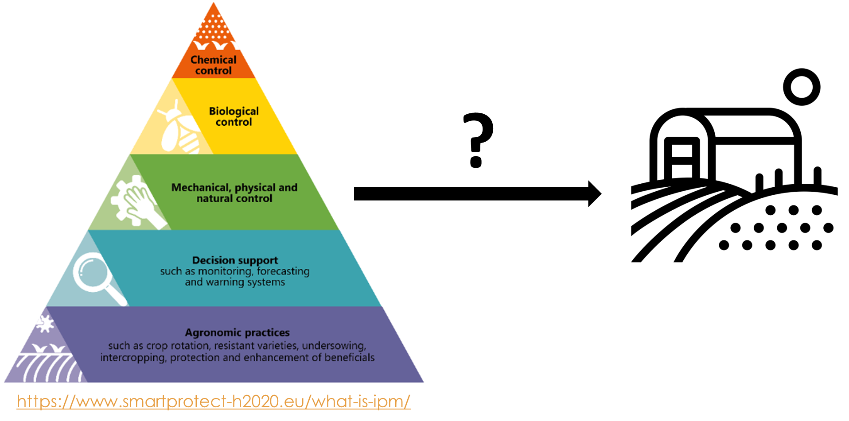
Stakeholder event, Brussel, 13/02/2024

Slide 3
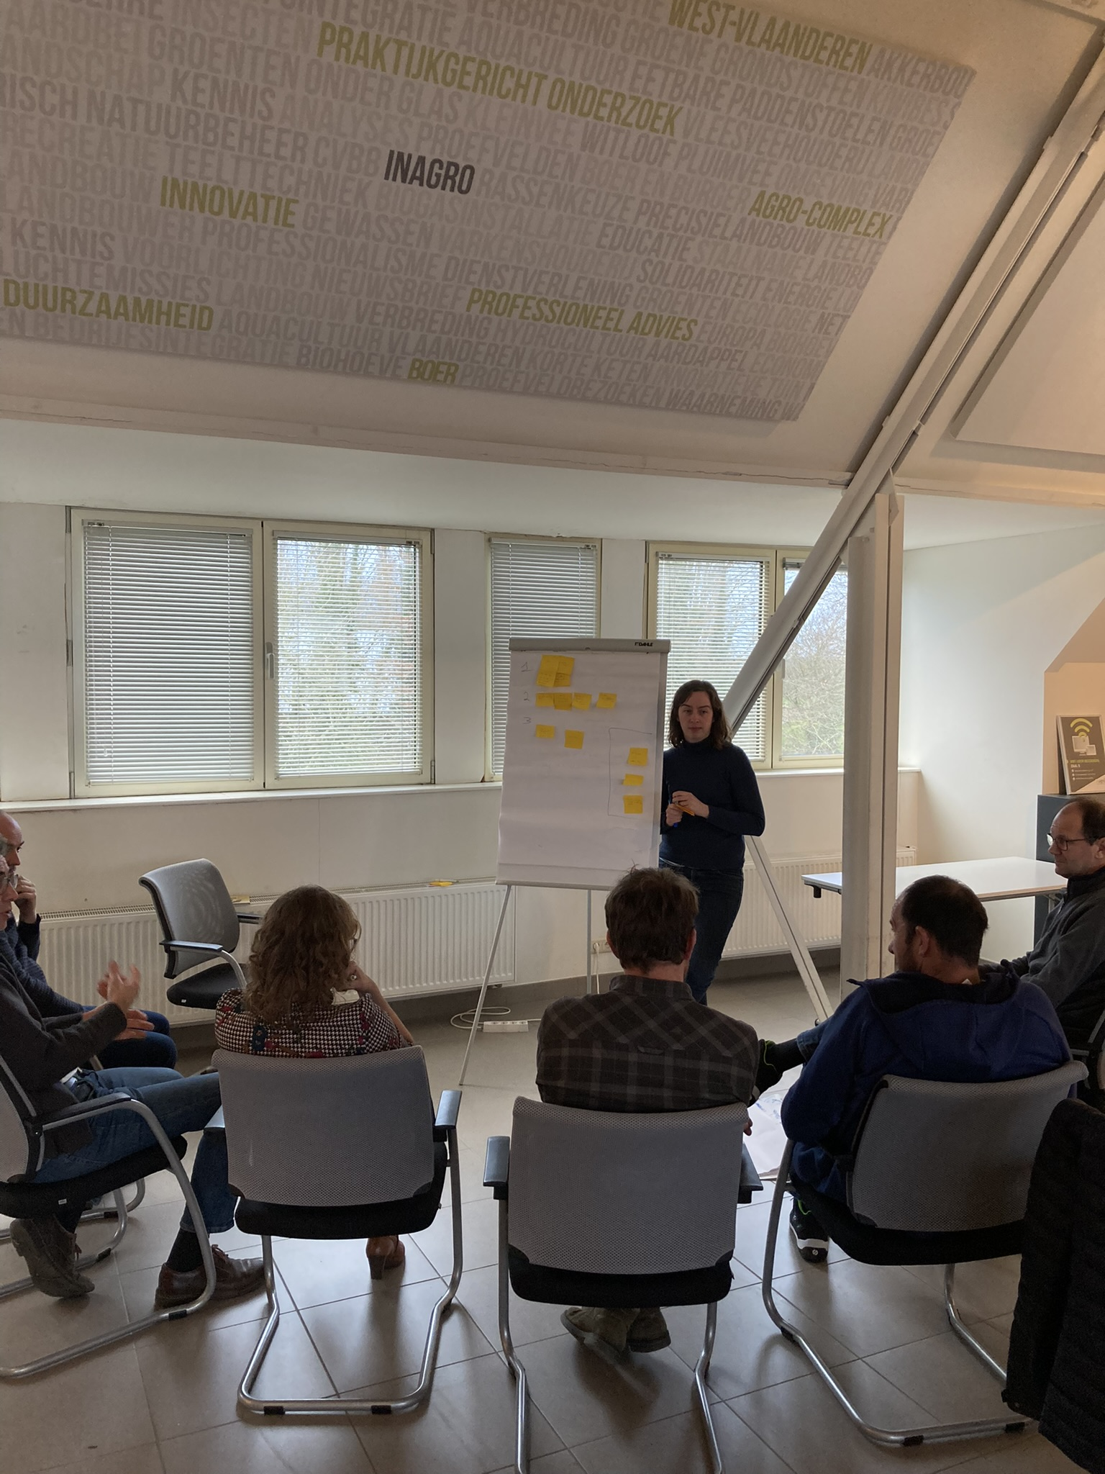
IPM is … Abstract
Plagen, ziekten en onkruiden afhankelijk van: teelt, seizoen, bedrijf, etc.
Handelingsperspectief (wanneer wat hoe waarom)
(Lamichhane et al., 2016, 2017), (Ehler, 2006), (Creissen et al., 2021)
HUB
Gebaseerd op noden en capaciteiten telers
Strategie op bedrijfsniveau
Experiment
Demonstratie
Stakeholder event, Brussel, 13/02/2024

Slide 4
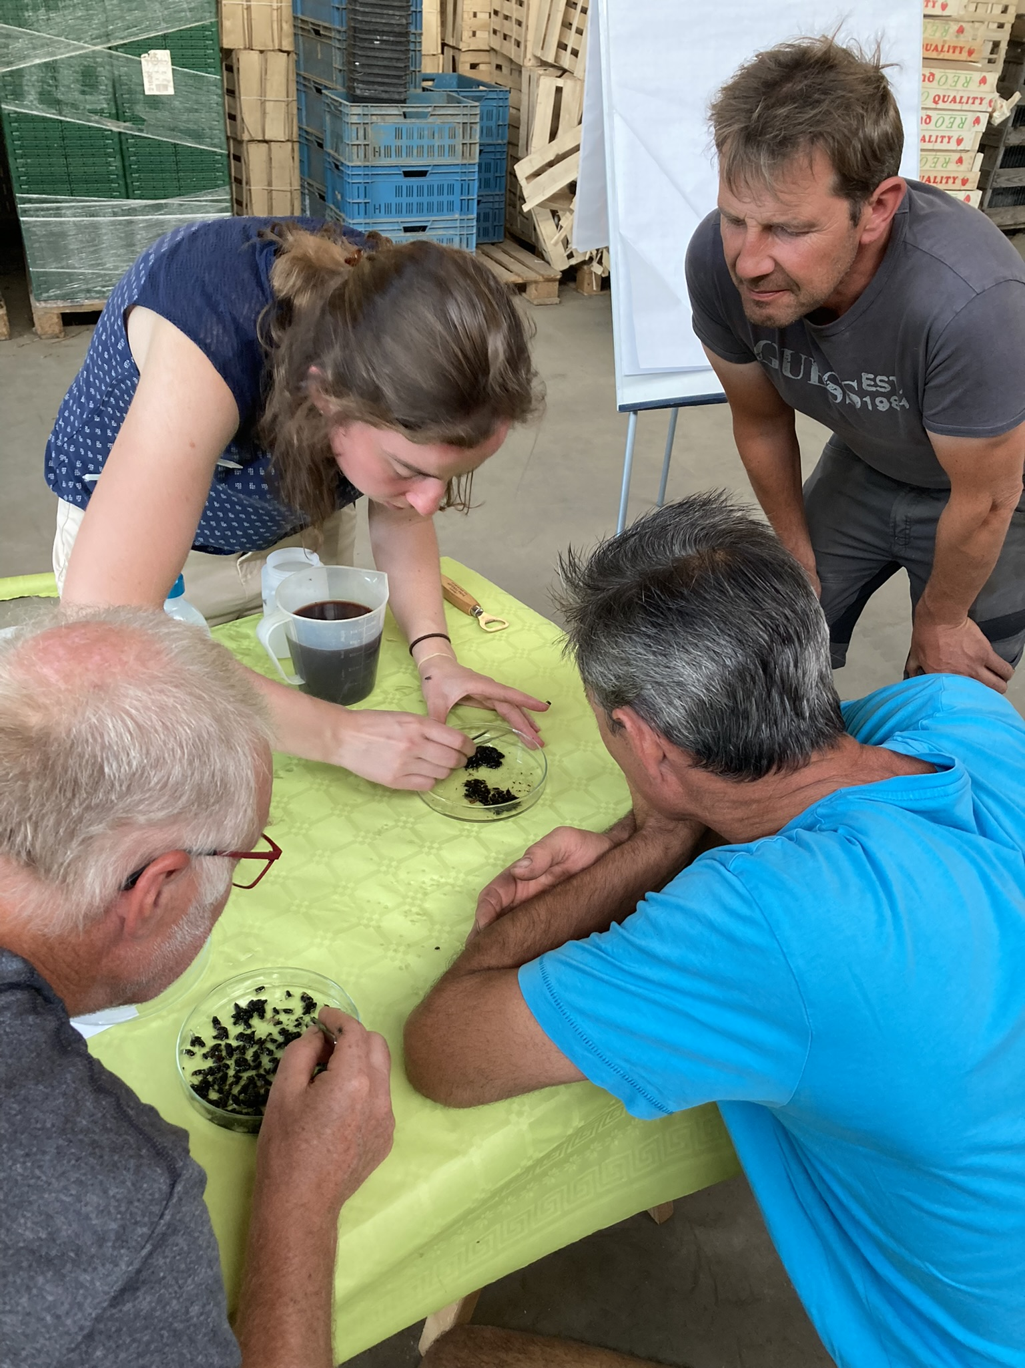
IPM is … Ecologisch
Landschapseffecten
Bedrijf als ecologie
(Vänninen et al., 2015), (J.-P. Deguine et al., 2021, 2023)
HUB
Samenwerkingsplatform
Analyse & kennisopbouw
Monitoring
Onafhankelijk teeltadvies
Stakeholder event, Brussel, 13/02/2024

Slide 5
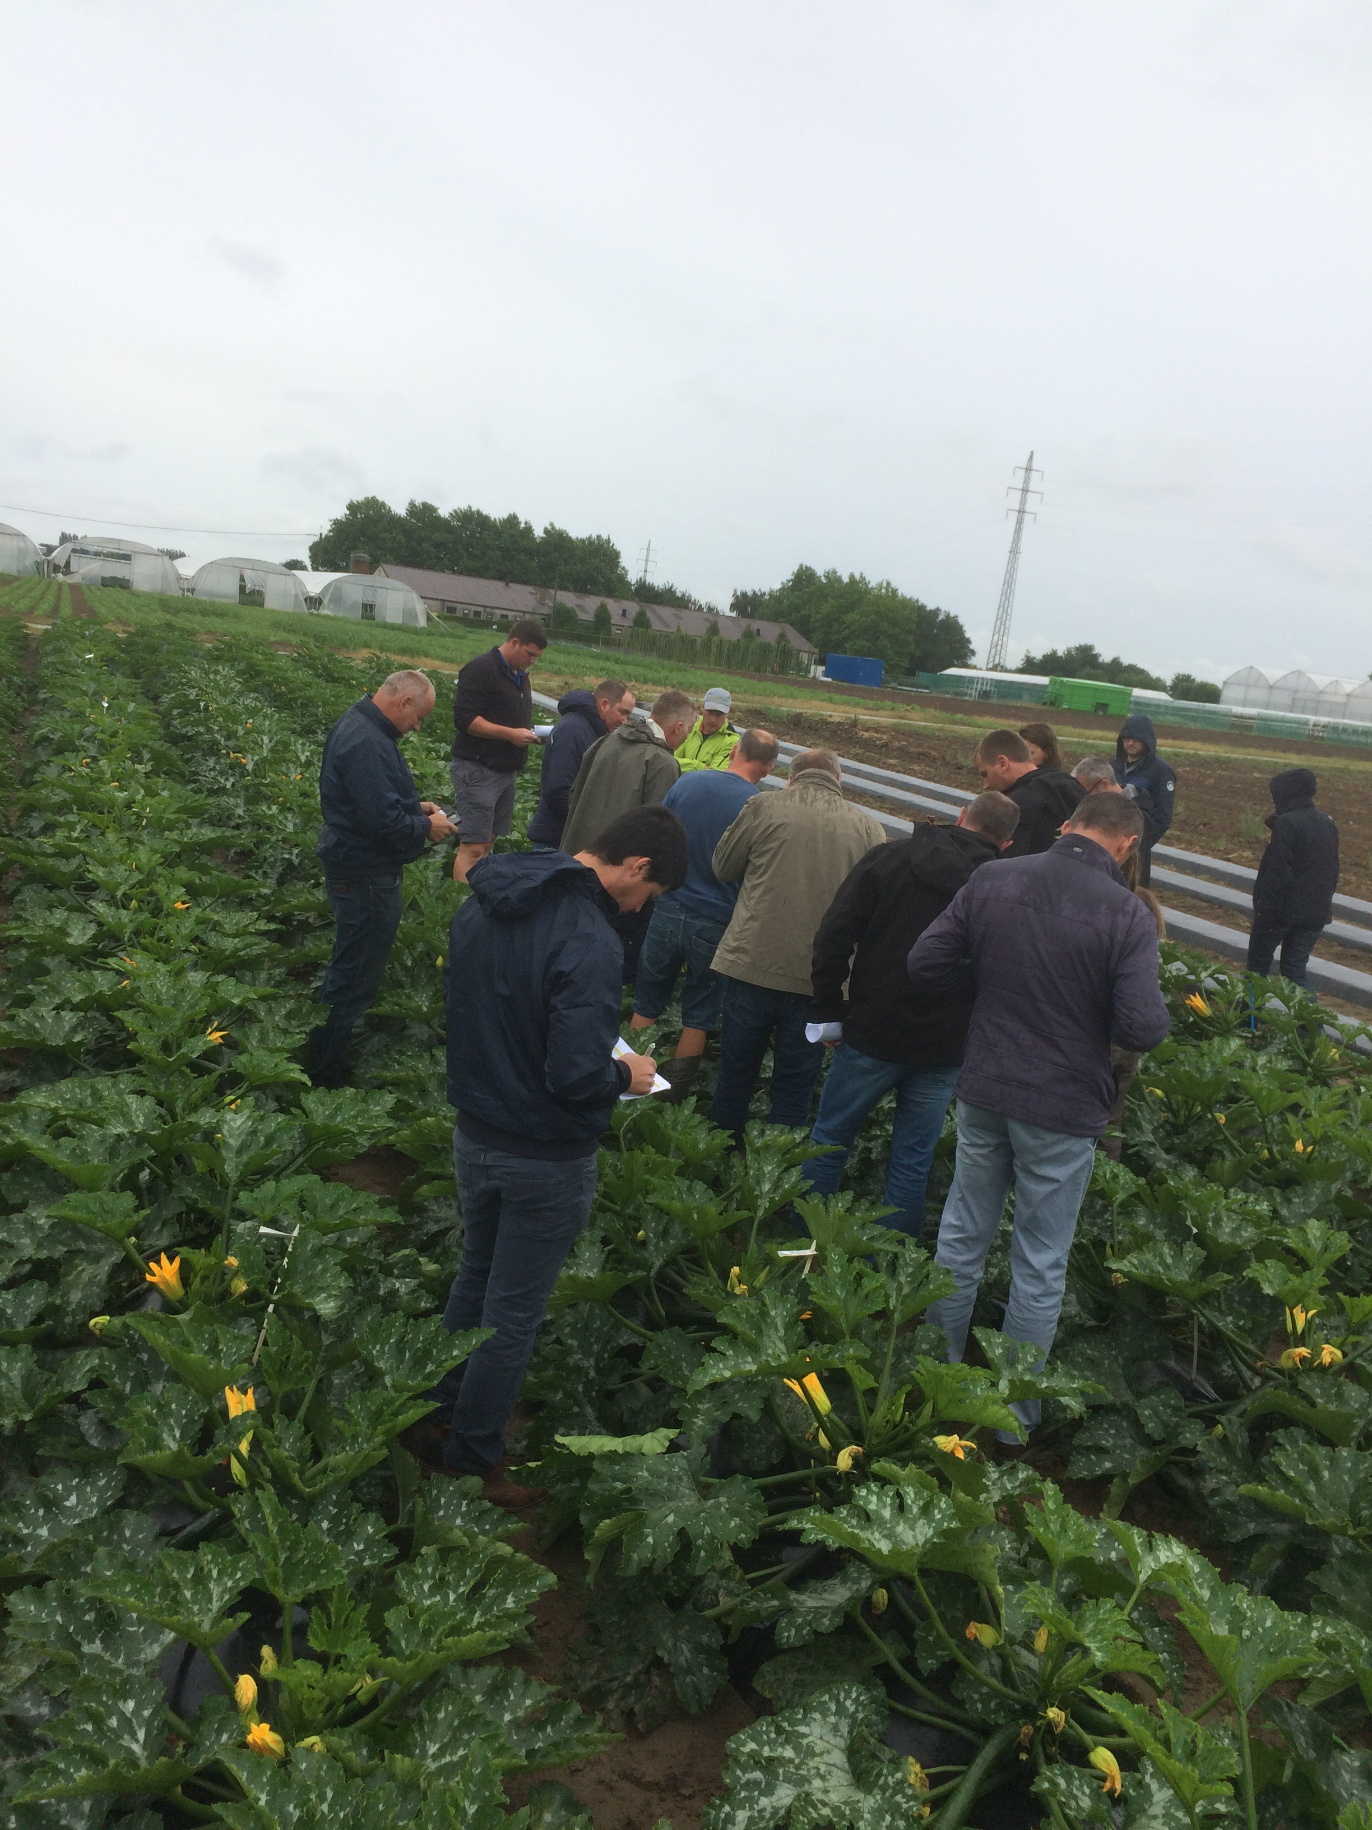
IPM is … Systemisch
Agro-voedingssysteem (input aanbod, verloning, ...)
Bedrijfssysteem
1 maatregel = bedrijfsorganisatie
combinatie van maatregelen)
(Stenberg, 2017), (Bakker et al., 2021), (Meunier et al., 2024)
HUB
Onderhandelingsplatform
Praktijkkennis
Holistisch
Stakeholder event, Brussel, 13/02/2024

Slide 6
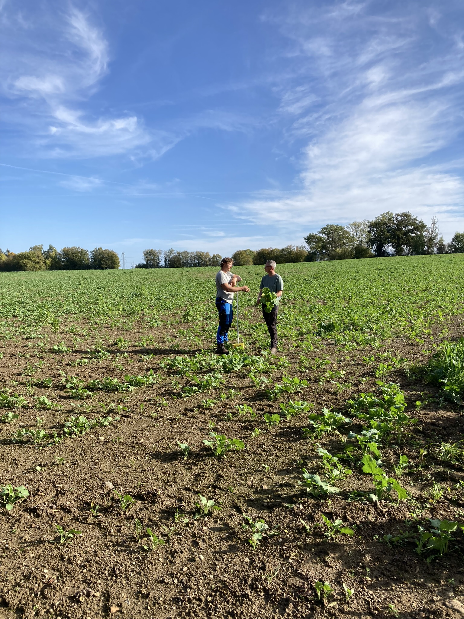
IPM is … Normatief
‘juiste’ richting
Productiecultuur
(Burton, 2004), (Loeber et al., 2009)
HUB
Voorbeeldfunctie
Betekenisgeving groep
Stakeholder event, Brussel, 13/02/2024

Slide 7
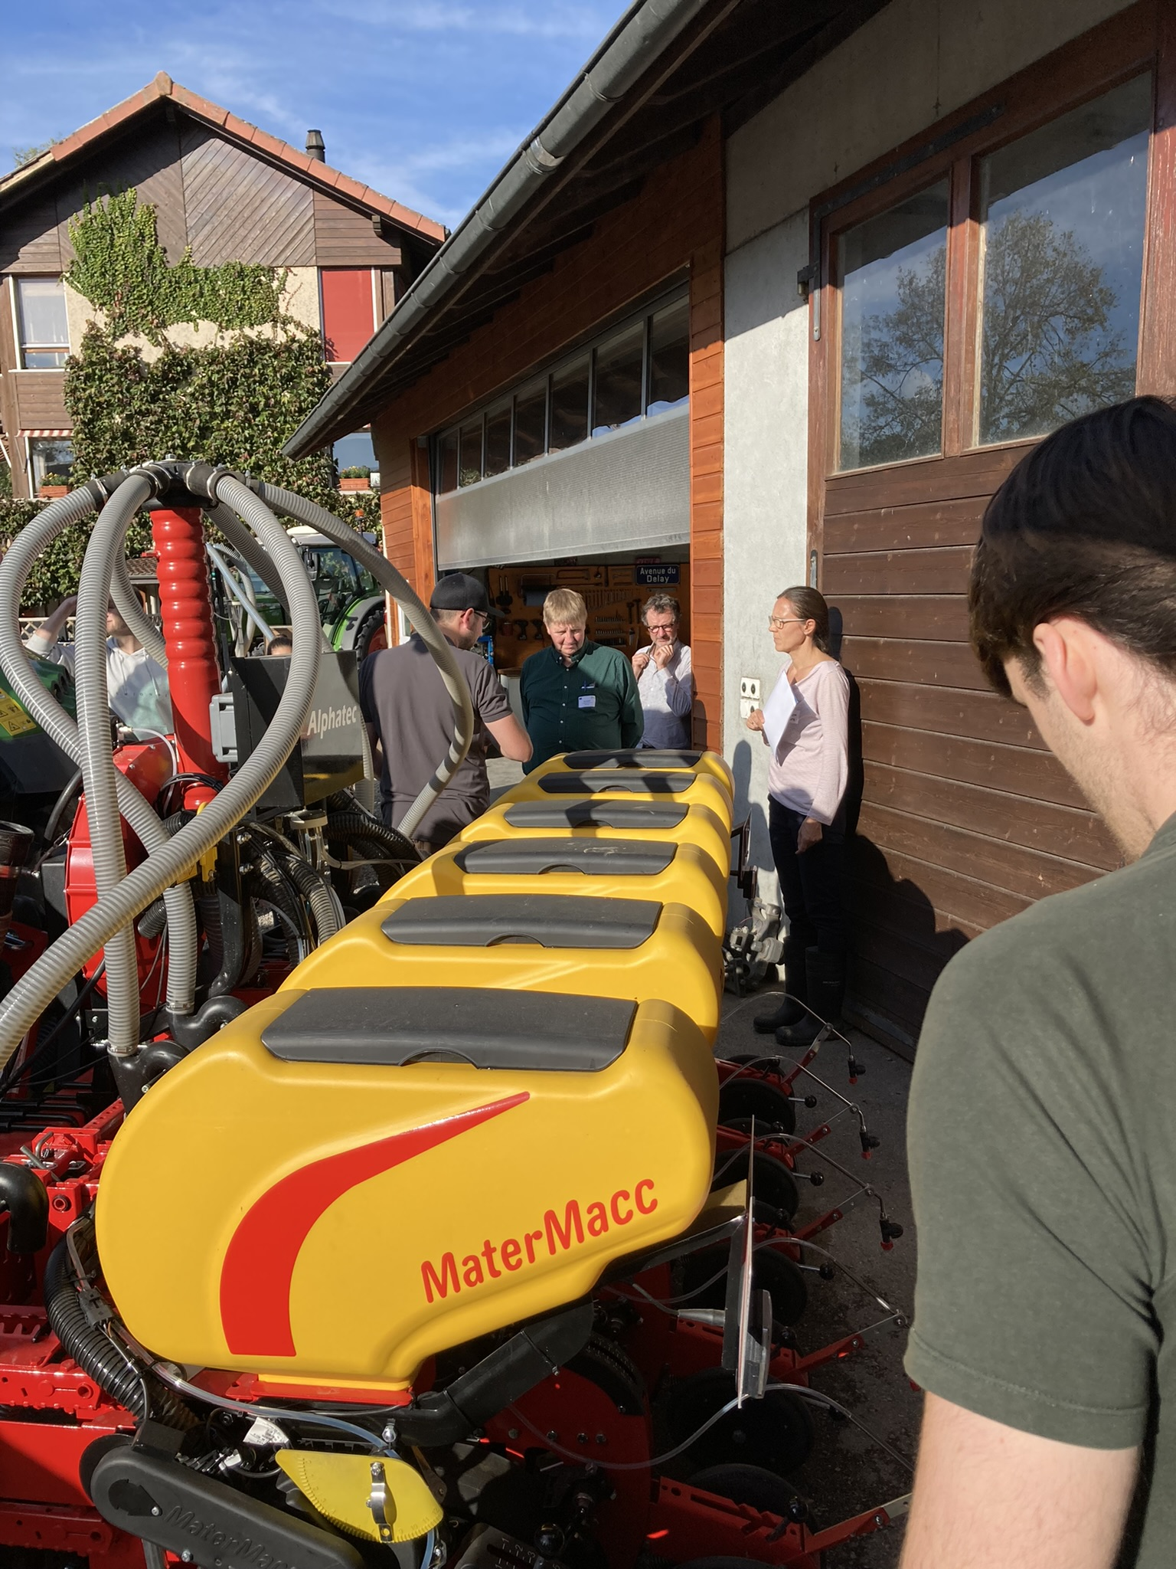
IPM is … Sociaal
Binnen sociaal-economische mogelijkheden
Welzijn
(Bartlett, 2008), (Barrera, 2020), (Moss, 2019)
HUB
Informeel
Gemeenschap, peer support
Stakeholder event, Brussel, 13/02/2024

Slide 8
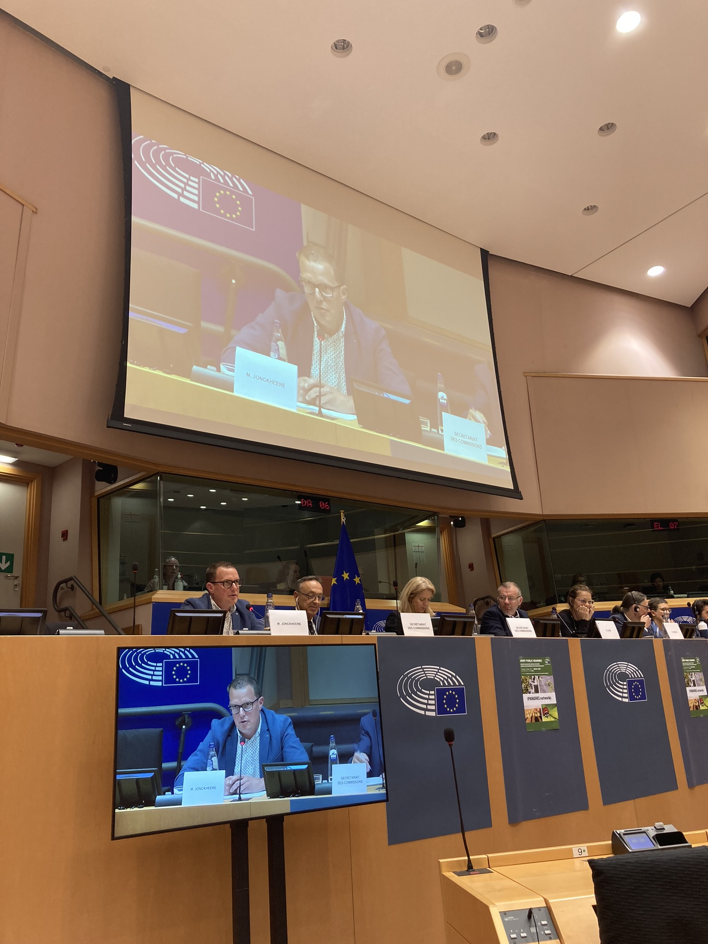
IPM is … Politiek
Veelheid aan doelstellingen
(Bjørnåvold et al., 2022), (Lee et al., 2019)
HUB
Wat kan er binnen de capaciteiten v/e bedrijf
Gespreksplatform
Stakeholder event, Brussel, 13/02/2024

Slide 9
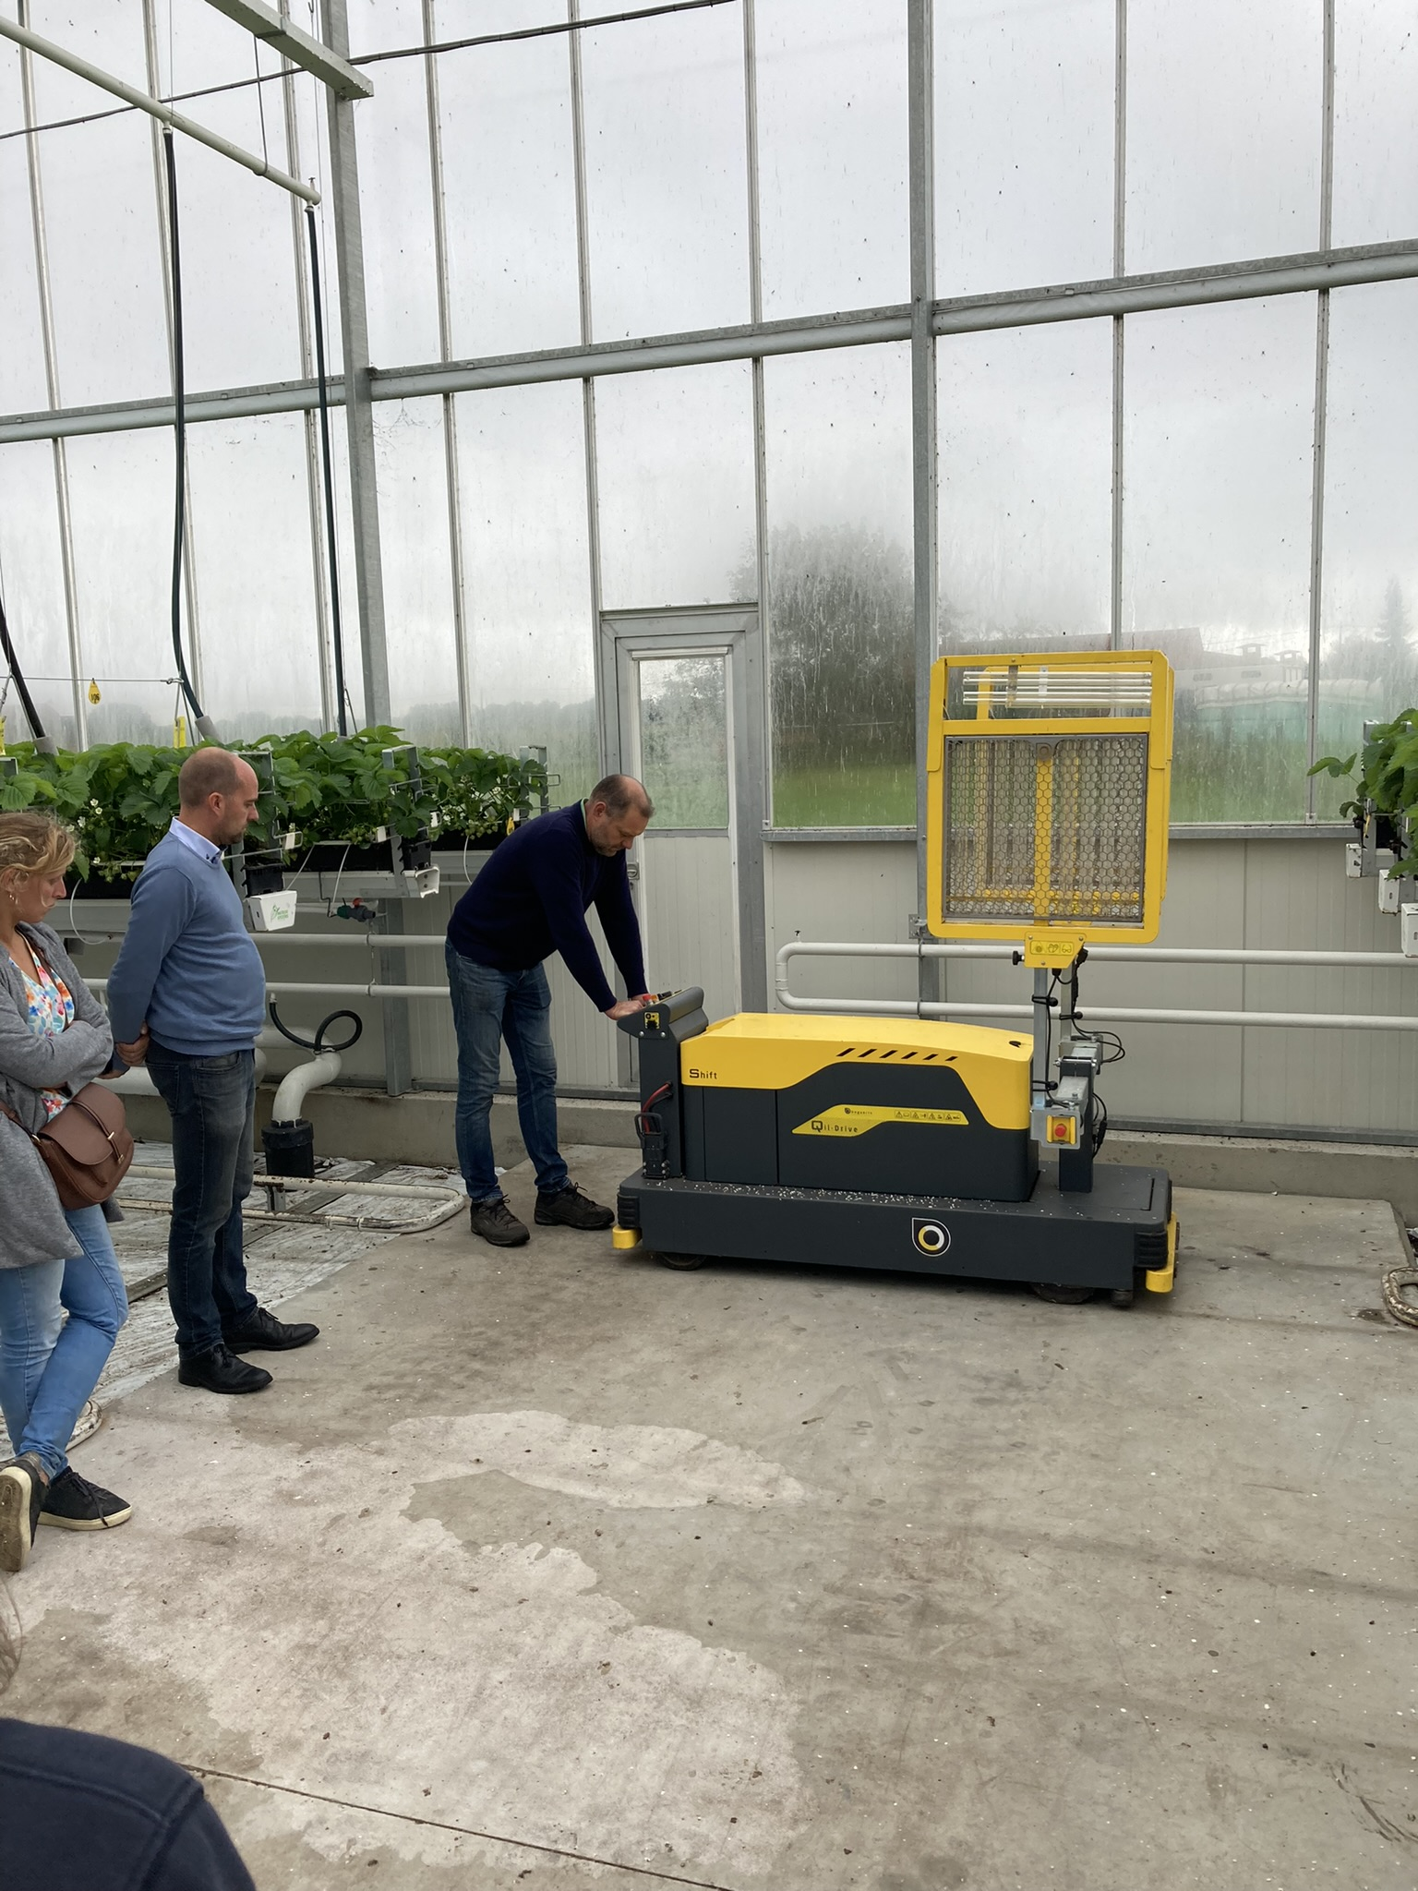
IPM is … Onbekend
Maatschappelijke opinie
Label
Effecten
(Lamine, 2011), (Finger & Möhring, 2022)
HUB
Communicatiekanaal
Marketing
Stakeholder event, Brussel, 13/02/2024

Slide 10
IPM | Hub
Abstract | Demonstraties, Veld experiment
Ecologisch | Monitoring, teeltadvies
Systemisch | Experten, bedrijfsbezoek
Normatief | Voorlopers, groep
Sociaal | Informeel, peers
Politiek | Netwerk
Onbekend | Communicatiekanalen, voorbeelden

Slide 11
Bakker, L., Sok, J., van der Werf, W., & Bianchi, F. J. J. A. (2021). Kicking the Habit: What Makes and Breaks Farmers’ Intentions to Reduce Pesticide Use? Ecological Economics, 180. https://doi.org/10.1016/j.ecolecon.2020.106868
Barrera, J. F. (2020). Holistic Pest Management. In Area-Wide Management of Fruit Fly Pests.
Bartlett, A. (2008). No more adoption rates! Looking for empowerment in agricultural development programmes. Development in Practice, 18(4–5), 524–538. https://doi.org/10.1080/09614520802181269
Bjørnåvold, A., David, M., Bohan, D. A., Gibert, C., Rousselle, J. M., & Van Passel, S. (2022). Why does France not meet its pesticide reduction targets? Farmers’ socio-economic trade-offs when adopting agro-ecological practices. Ecological Economics, 198. https://doi.org/10.1016/j.ecolecon.2022.107440
Burton, R. J. F. (2004). Seeing through the “good farmer’s” eyes: Towards developing an understanding of the social symbolic value of “productivist” behaviour. Sociologia Ruralis, 44(2), 195–215. https://doi.org/10.1111/j.1467-9523.2004.00270.x
Creissen, H. E., Jones, P. J., Tranter, R. B., Girling, R. D., Jess, S., Burnett, F. J., Gaffney, M., Thorne, F. S., & Kildea, S. (2021). Identifying the drivers and constraints to adoption of IPM among arable farmers in the UK and Ireland. Pest Management Science, 77(9), 4148–4158. https://doi.org/10.1002/ps.6452
Deguine, J. P., Aubertot, J. N., Bellon, S., Côte, F., Lauri, P. E., Lescourret, F., Ratnadass, A., Scopel, E., Andrieu, N., Bàrberi, P., Becker, N., Bouyer, J., Brévault, T., Cerdan, C., Cortesero, A. M., Dangles, O., Delatte, H., Dinh, P. T. Y., Dreyer, H., … Lamichhane, J. R. (2023). Agroecological crop protection for sustainable agriculture. Advances in Agronomy, 178, 1–59. https://doi.org/10.1016/bs.agron.2022.11.002
Deguine, J.-P., Aubertot, J.-N., Flor, R. J., Lescourret, F., Wyckhuys, K. A. G., & Ratnadass, A. (2021). Integrated pest management: good intentions, hard realities. A review. Agronomy for Sustainable Development , 41(38). https://doi.org/10.1007/s13593-021-00689-w/Published
Ehler, L. E. (2006). Integrated pest management (IPM): Definition, historical development and implementation, and the other IPM. Pest Management Science, 62(9), 787–789. https://doi.org/10.1002/ps.1247
Finger, R., & Möhring, N. (2022). The adoption of pesticide-free wheat production and farmers’ perceptions of its environmental and health effects. Ecological Economics, 198. https://doi.org/10.1016/j.ecolecon.2022.107463
Lamichhane, J. R. (2017). Pesticide use and risk reduction in European farming systems with IPM: An introduction to the special issue. Crop Protection, 97, 1–6. https://doi.org/10.1016/j.cropro.2017.01.017
Lamichhane, J. R., Aubertot, J. N., Begg, G., Birch, A. N. E., Boonekamp, P., Dachbrodt-Saaydeh, S., Hansen, J. G., Hovmøller, M. S., Jensen, J. E., Jørgensen, L. N., Kiss, J., Kudsk, P., Moonen, A. C., Rasplus, J. Y., Sattin, M., Streito, J. C., & Messéan, A. (2016). Networking of integrated pest management: A powerful approach to address common challenges in agriculture. In Crop Protection (Vol. 89, pp. 139–151). Elsevier Ltd. https://doi.org/10.1016/j.cropro.2016.07.011
Lamine, C. (2011). Transition pathways towards a robust ecologization of agriculture and the need for system redesign. Cases from organic farming and IPM. Journal of Rural Studies, 27(2), 209–219. https://doi.org/10.1016/j.jrurstud.2011.02.001
Lee, R., den Uyl, R., & Runhaar, H. (2019). Assessment of policy instruments for pesticide use reduction in Europe; Learning from a systematic literature review. Crop Protection, 126. https://doi.org/10.1016/j.cropro.2019.104929
Loeber, A., van Mierlo, B., Grin, J., & Leeuwis, C. (2009). The practical value of theory: Conceptualising learning in the pursuit of a sustainable development. In A. Wals (Ed.), Social learning towards a sustainable world (pp. 83–98).
Meunier, E., Smith, P., Griessinger, T., & Robert, C. (2024). Understanding changes in reducing pesticide use by farmers: Contribution of the behavioural sciences. Agricultural Systems, 214. https://doi.org/10.1016/j.agsy.2023.103818
Moss, S. (2019). Integrated weed management (IWM): why are farmers reluctant to adopt non-chemical alternatives to herbicides? Pest Management Science, 75(5), 1205–1211. https://doi.org/10.1002/ps.5267
Stenberg, J. A. (2017). A Conceptual Framework for Integrated Pest Management. Trends in Plant Science, 22(9), 759–769. https://doi.org/10.1016/j.tplants.2017.06.010
Vänninen, I., Pereira-Querol, M., & Engeström, Y. (2015). Generating transformative agency among horticultural producers: An activity-theoretical approach to transforming Integrated Pest Management. Agricultural Systems, 139, 38–49. https://doi.org/10.1016/j.agsy.2015.06.003

Slide 12
Abstract concept → vertalen naar een praktijk concept, aangepast aan sector, gewassen, klimaat, bedrijf, teler, etc.
Ecologisch concept → bedrijf als ecosysteem denken = kennisintensief, nood aan permanentere begeleiding
Geaggregeerde effecten → landschap schaal, markt werking, publieke opinie, etc
Geen erkenning zoals bio → communicatie en toonbeeld dat er iets gedaan wordt
Systeem effecten → implementatie één IPM maatregel heeft veel gevolgen voor bedrijfsogranisatie (niet gekend, zelden onderzocht, moet je zien in de praktijk ‘praktijkkennis’) kracht van voorgaande ervaringen
Normatief concept → identiteit & cultuur kwesties, nood aan community, peer support
Politieke doelstellingen → platform voor uitwisseling
IPM ook een sociaal concept → welzijn teler, peer support
Stakeholder event, Brussel, 13/02/2024

